Slide 1
Gauss seidal METHOD
By
Doyel Sarkar

Slide 2
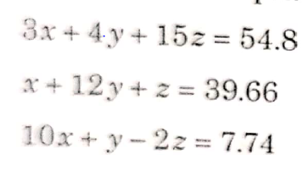
SOLVE

